Slide 1

Research Question – Tutorial Presentation for Feedback Date: 13/11/2024
Group Name: A026 Name of Student Presenting: Mohammed Riyan Ahmed

Slide 2
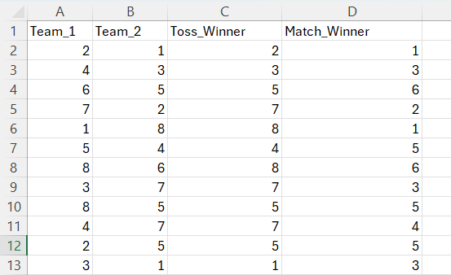
Indian Premier league(IPL Cricket) until 2016
The Dataset has 578 Rows

Slide 3
This dataset is interesting to us because (one sentence): We Love playing Cricket and excited to work on the probabilities either of Teams Winning or Losing. From the column headings in your dataset choose ONE independent * and ONE dependent variable . Our Independent variable is: ( Toss_Winner ) This Independent variable datatype is (select one): Nominal Our Dependent variable is:( Match_Winner ) This Dependent variable datatype is (select one): Nominal
Dataset ID: (DS238 and Match.csv) Indian Premier league(IPL Cricket) until 2016
*For comparison of two nominal variables and for comparison of proportions you use two (or more) independent variables (see next slide)
Notes:
Before specifying your Research Question you must define the type of data you are analysing. Are the variables you select interval data (measurement data you can divide, multiple, etc), OR are they ordinal (there is a definite order but the intervals between each variable are not necessarily equal, or the terms might be subjective like in a likert scale); OR are they just categorical/nominal (Items such as film names, cities, etc., that you can count numbers of occurrences? You also need to understand whether the variable is either dependent or independent and this will vary according to the context. Independent variables may cause an effect, whereas the dependent variable might be effected by the independent variable. Check the lecture notes on the RQ for more information and examples.
You will get only one opportunity to present your Research Question ahead of the submission date. Have your questions ready, and be ready to take notes on feedback.

Slide 4
Is there a difference in the proportions of matches won (Match_Winner) between teams that won the toss (Toss_Winner) and teams that did not win the toss (Not Toss_Winner)?
Our Research Question is :
¹Correlation (Analysis of how ordinal/interval dependent var correlates to an ordinal/interval independent variable)
²Comparison of means (or medians): Analysis of the difference between the mean (or median) value of a characteristic shared by members of two different populations.
³Comparison of proportions: Analysis of the difference in proportions of a characteristic shared by members of two different populations.

Slide 5
Hypothesis:
1. Null hypothesis (H₀): There is no difference in the proportion of Matches won (dependent variable) between teams that won the Toss and those that did not (independent variable).
2. Alternative hypothesis (H₁): There is a difference in the proportion of Matches won (dependent variable) between teams that won the Toss and those that did not (independent variable).
Leave the hypotheses as two statements for now – after your statistical analysis test, you will choose one or the other. (You will report: "We fail to reject the null hypothesis" with no significant result, or if you do have significance [p-value = < 0.05] you can state "We reject the null hypothesis". More guidance on hypothesis testing is given in the lectures.)

